Slide 1


COURSE MANAGEMENT SYSTEM
G.PUNEETH
K.THEJESH REDDY
M.HEMANTH

Slide 2
CONTENTS
INTRODUCTION
TECHNICAL TIPS
PEDAGOGICAL TIPS
SOME EXAMPLES OF CMS SOFTWARE
INPUTS & OUTPUTS

Slide 3
INTRODUCTION
An integrated email tool allowing participants to send announcement email messages to the entire class or to a subset of the entire class.A chat tool allowing a synchronous communication among class participants.A threaded discussion board allowing a synchronous communication among participants.
In addition, a CMS is typically integrated with other databases in the university so that students enrolled in a particular course are automatically registered in the CMS as participants in that course.
An integrated email tool allowing participants to send announcement email messages to the entire class or to a subset of the entire class. A chat tool allowing a synchronous communication among class participants. A threaded discussion board allowing a synchronous communication among participants.
In addition A CMS is typically integrated with other databases in the university so that students enrolled in a particular course are automatically registered in the CMS as participants in that course.

Slide 4
TECHNICAL TIPS
1. Planning and Requirements Gathering
Identify Features: Determine the key features your course management system needs, such as user authentication, course creation, enrollment, content management, quizzes, and grading.
Target Audience: Understand the needs of your users (students, teachers, administrators) to tailor the functionality accordingly.
2. Design
Wireframing: Create wireframes to outline the basic layout and user interface of the website. Tools like Figma or Adobe XD can be useful.
User Experience (UX): Focus on creating an intuitive and user-friendly interface. Ensure easy navigation and accessibility.
Responsive Design: Make sure the website is responsive and works well on different devices and screen sizes.

Slide 5
4. Development
Set Up Environment: Set up your development environment with necessary tools like code editors (VS Code), version control (Git), and package managers (npm, pip).
Modular Code: Write modular and reusable code. Follow the MVC (Model-View-Controller) pattern if applicable.
Testing: Implement unit testing and integration testing to ensure code quality and functionality. Use frameworks like Jest, Mocha, or PyTest.
Version Control: Use Git for version control and collaboration. Platforms like GitHub or GitLab can facilitate this.
5. Features Implementation
User Authentication: Implement registration, login, and profile management.
Course Management: Create features for adding, updating, and deleting courses.
Content Management: Allow instructors to upload and manage course materials (videos, documents, etc.).
Enrollment: Implement functionality for students to enroll in courses.
Quizzes and Grading: Add features for creating quizzes, submitting assignments, and grading.
Notifications: Implement a notification system for important updates and reminders.

Slide 6
6. Security
Data Validation: Validate all user inputs to prevent SQL injection and XSS attacks.
Encryption: Use HTTPS and encrypt sensitive data, such as passwords.
Access Control: Implement role-based access control to restrict certain features to authorized users only.
7. Deployment
Hosting: Choose a reliable hosting provider (AWS, Heroku, DigitalOcean).
CI/CD: Set up Continuous Integration and Continuous Deployment pipelines to automate testing and deployment.
Domain and SSL: Purchase a domain name and set up SSL for secure communication.
8. Monitoring and Maintenance
Monitoring: Use tools like Google Analytics, New Relic, or Sentry for monitoring website performance and errors.
Regular Updates: Keep the system updated with the latest security patches and improvements.
User Feedback: Collect user feedback to continuously improve the system.

Slide 7
PEDAGOGICAL TIPS
1. Clear Learning Objectives
Define Objectives: Clearly outline the learning objectives for each course and module. Make sure students understand what they are expected to learn.
Alignment: Ensure that all course materials, activities, and assessments are aligned with these objectives.
2. Engaging Content
Variety of Materials: Use a mix of text, videos, interactive simulations, and other multimedia to cater to different learning styles.
Real-World Examples: Incorporate real-world examples and case studies to make the content more relatable and engaging.
3. Interactive Elements
Discussion Forums: Provide forums or discussion boards for students to interact with each other and the instructor.
Quizzes and Polls: Use quizzes, polls, and other interactive elements to keep students engaged and assess their understanding in real-time.
4. Feedback Mechanisms
Timely Feedback: Provide timely and constructive feedback on assignments and quizzes to help students improve.
Peer Feedback: Encourage peer reviews and discussions to enhance collaborative learning.

Slide 8
5. Flexible Learning Paths
Self-Paced Learning: Allow students to progress at their own pace, especially for online or asynchronous courses.
Adaptive Learning: Use adaptive learning technologies to tailor content and assessments to the individual needs of students.
6. Collaborative Learning
Group Projects: Incorporate group projects and collaborative activities to foster teamwork and communication skills.
Study Groups: Facilitate the formation of study groups for peer support and collaborative learning.
7. Assessment and Evaluation
Diverse Assessments: Use a variety of assessment methods (quizzes, projects, exams, peer reviews) to evaluate different aspects of student learning.
Formative Assessments: Include formative assessments to monitor student progress and provide feedback throughout the course.

Slide 9
SOME EXAMPLES OF CMS SOFTWARE
MOODLE
CANVAS
BLACK BOARD LEARN
GOOGLE CLASSROOM
SCHOOLOGY
TALENT LMS
UDEMY FOR BUSINESS

Slide 10
INPUT & OUTPUTS

Slide 11
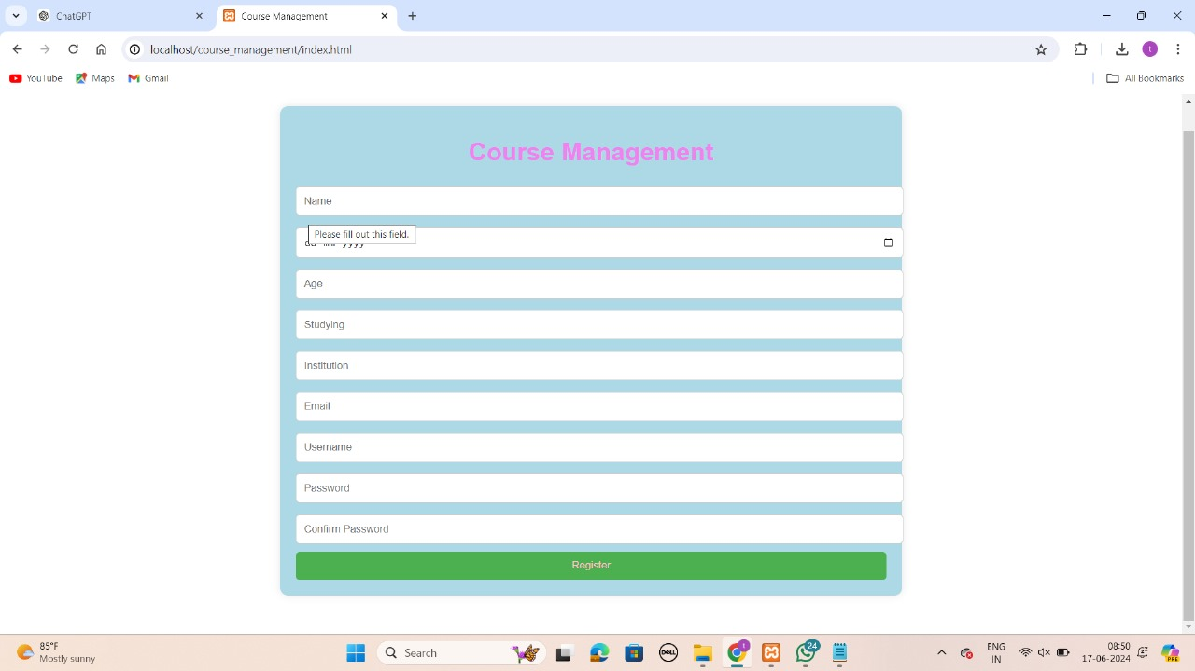

Slide 12
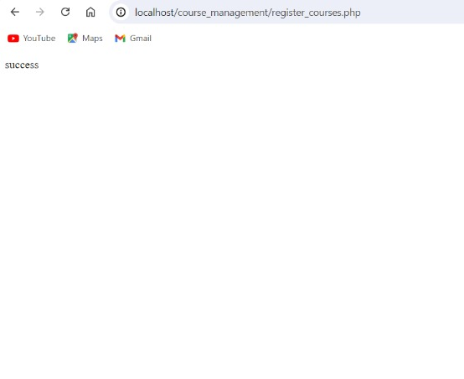


Slide 13
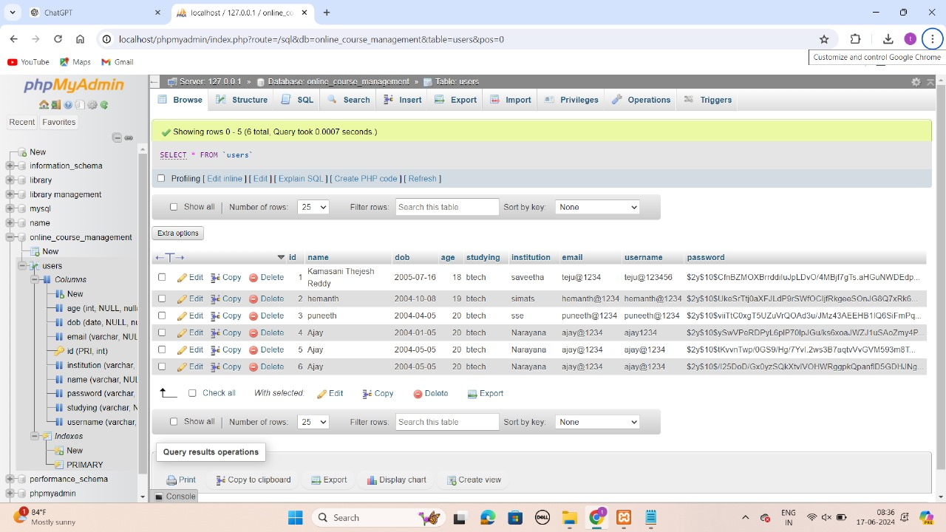

Slide 14


